Slide 1
Agent-based modelling in Graphics
ft. The Sims 3
MAS MANDATE - 1
IMT2019525 VIJAY JAISANKAR

Slide 2
Intent of this mandate
To showcase some of the intricacies and nuances of modelling agents in graphics applications.

Slide 3
ABMs focus on modeling agency and autonomous behaviour from the
view-point of agents.

Slide 4
But, what are these agents?
A hardware/software-based computer system that has the following properties:
Autonomy
Some kind of control over their actions and internal state
Social ability
Interacting with other agents (and possibly humans)
Reactivity
Perceive their environment and react to changes
Proactiveness
Taking the initiative

Slide 5
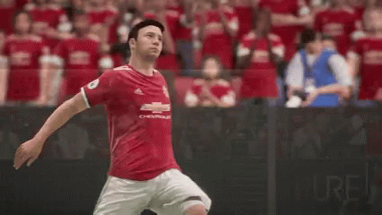
What do you notice?
How does the crowd behave?

Slide 6
Believability
The environment should be populated with life-like virtual characters

Slide 7
The potential issues with believability
Sometimes, we need to design the most interesting and believable character, as opposed to the most efficient one.

Slide 8

Artistic tendencies of characters
What if he snapped twice?

Slide 9
Virtual Fidelity
The virtual world needs to “ring true” with the real world as per the requirements of the system - different levels of realism in movies and games

Slide 10
Spectrum of Agents
Physical agents
Simulation of believable physical behavior, like muscles and skeletons.
Cognitive agents
Simulation of decision making, planning, reasoning, and learning.

Slide 11

What do you think is more important for a game released in 2023?

Slide 12
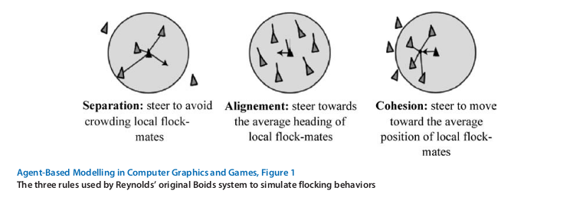
Emergence
Emergence of complicated flocking behaviour!

Slide 13
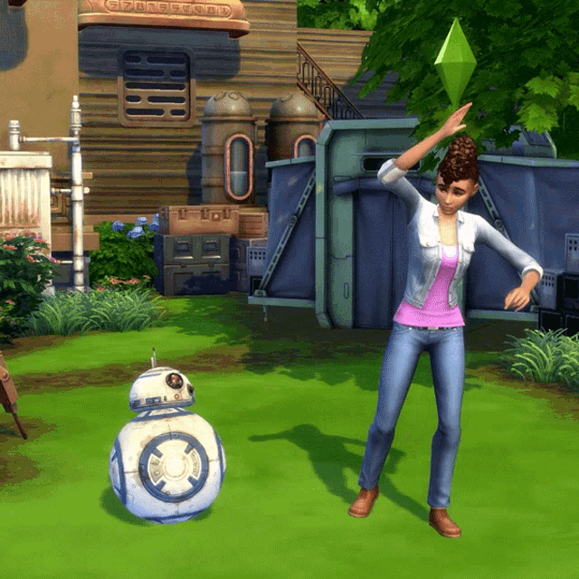
The Sims franchise
Hugely popular life simulation game, where the player controls one or more sims.

Slide 14
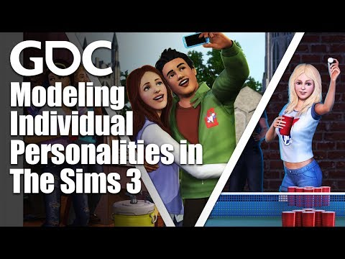
Chief resource for this discussion
Game Developers Conference talk about The Sims 3

Slide 15
Chief design objectives
Having a system which enables emergent narratives
Simulate a larger and varied living world
Make unique sims
Data-driven approach

Slide 16
Simulating a larger world
Store a map from things we might want (“commodities”) to interactions which satisfy that commodity.
Eg: Energy: {Nap, Drink}
When the protagonist reaches a venue, there should already be spawned sims and existing suitable and situation specific behaviour.

Slide 17
Simulating a larger world
Every agent has motives
Venues have them too!
Hierarchical
Optimisation
Foreground sims
Background sims

Slide 18
Story progression
P: Update the motives when the sim comes to the foreground.
Does P leave something out?

Slide 19
Story progression: Long-term goals
Other sims need to make progress even if they’re not being fully simulated - marriage, college, etc.
Town has meta-level desires.

Slide 20
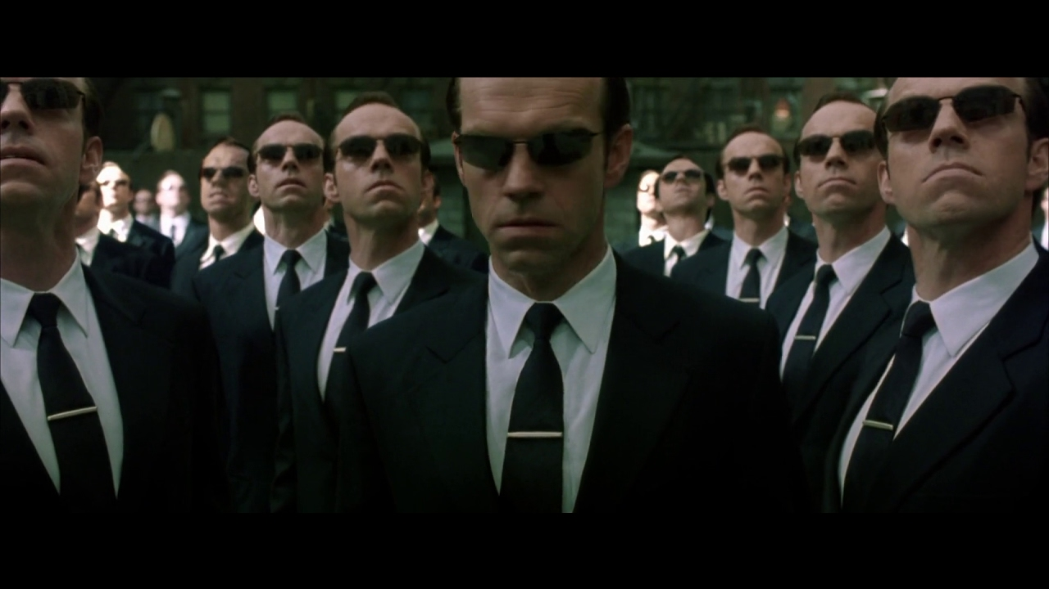
Variability
There should be many unique sims to complement the varied and large world.

Slide 21
Traits and Motives
A personality is a bag of traits
There is a new motive for each trait
Different sims have different motives
Motives vary between individuals and time
By satisfying their unique wants, the agents are manifesting their individual personality autonomously

Slide 22
Randomness
Q: Each action has a score; always choose the highest scoring action?
Would you enjoy a game with Q?

Slide 23
Preventing robotic behaviour
Choose randomly from one of the top k scored actions
Also, sample from Maslow’s hierarchy of needs

Slide 24
Personalities
They should be immediately obvious to the player
Yet, at the same time, there should be something left to learn
If we are going to have much finer grained personalities, we are going to need much more finer grained social interactions to support them
Trait learning is contextual

Slide 25
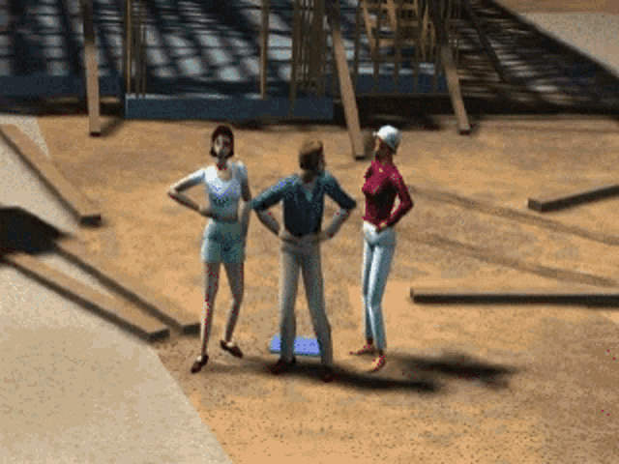
Trait conflict
Same action creates very different stories when the sims have different traits

Slide 26
Family activities
Various archetypes of sims
Society bonds and feuds

Slide 27
We looked at a lot of emergence among the agents
What about the players?

Slide 28
Players are
active agents negotiating both the game’s version of real life, and their own
real-world experiences.
Projection into the virtual world!

Slide 29
Some common play styles
How would you play the game yourself?

Slide 30
projection
emulating aspects (or wishful aspects) of real life in the game

Slide 31
cacoethes
def: the-one-and-only-thing-you-shall-not-ever-do

Slide 32
schadenfreude
pleasure derived from someone else’s pain

Slide 33
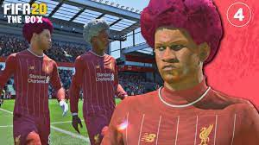
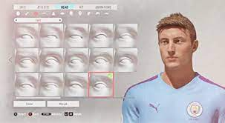
What design would you give your player (if you had to impulsively pick one)?

Slide 34
Expertly designed RPG games are seen as viable tools to evaluate ABM models and frameworks

Slide 35
References
https://www.tandfonline.com/doi/abs/10.1080/1369118032000163268 - Emergent human behaviour in games
https://www.sciencedirect.com/science/article/pii/S2352146517309572?via%3Dihub - RPGs as validations for ABMs
https://link.springer.com/article/10.1057/jos.2016.7 - More about ABMs
https://arrow.tudublin.ie/cgi/viewcontent.cgi?article=1000&context=scschcombk - ABM in CG and Games
https://www.youtube.com/watch?v=YjuOSgPdtS0 - Emergent Storytelling in the Sims
https://aliceandkev.wordpress.com/2009/06/09/alice-and-kev/ - Emergent Narrative Example
https://www.youtube.com/watch?v=DVMs5_B611E&t=2779s - Modelling individual personalities in the Sims 3
https://drive.google.com/file/d/1Xx8W2iKCDkJddiQnIOEze_1YxXd7e4Tq/view - MAS Slides
https://www.cs.ox.ac.uk/people/michael.wooldridge/pubs/ker95.pdf - Definition of Intelligent Agent
http://www.red3d.com/cwr/boids/ - Boids simulation

Slide 36
Thank you!

